Slide 1


PirateShip: Distributed Consensus for (Mostly) Trusted Execution Environments
Shubham Mishra, Chawinphat Tankuranand, Natacha Crooks,
Heidi Howard, Markus Kuppe

Slide 2
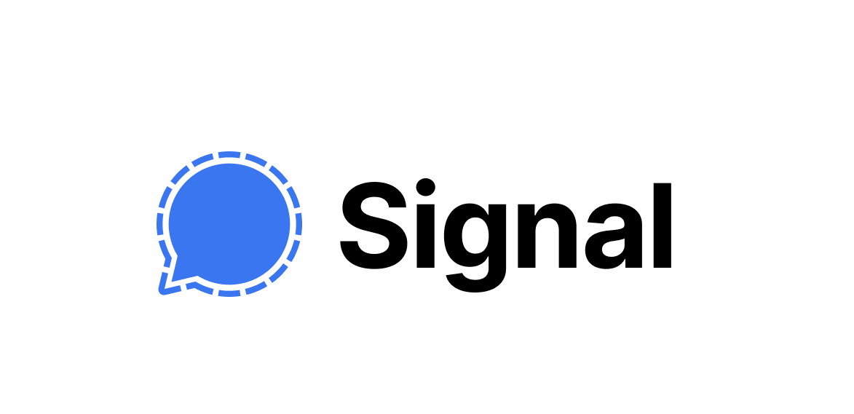
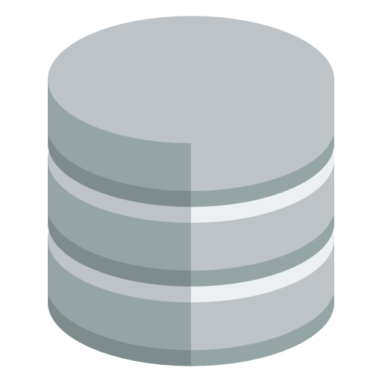
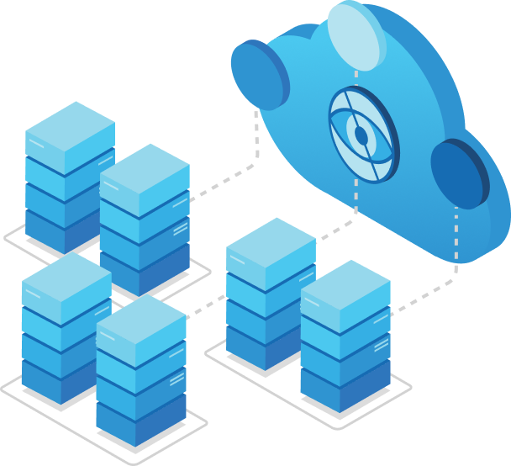
Distributed Trust
Deposit(A,5)
Deposit(B,2)
Transfer(A,15)
Transfer(B,15)
Notes:
Today I am going to talk about Distributed Trust: a system in which mutually distrustful participants want to reliably and securely share data among each other.
<Click>
Distributed Trust has a seen a lot of adoption in recent year to protect sensitive data. Two main examples are secret key recovery mechanisms deployed in Signal, and Microsoft’s Azure Confidential Ledger which is used for
<Click>
At the heart of such systems lies a ledger, which establishes a global total order of transactions or operations applied to each replica.

Slide 3


Independent Trust Domains
Notes:
Distributed Trust systems rely on replication to tolerate a fraction of the replicas misbehaving.
System administrators agree on a threshold a priori and deploy the requisite number of replicas.
<Click>
A central assumption in a such a deployment is that replicas fail independently.
That is: the event of one replica crashing or misbehaving is not correlated with another.

Slide 4
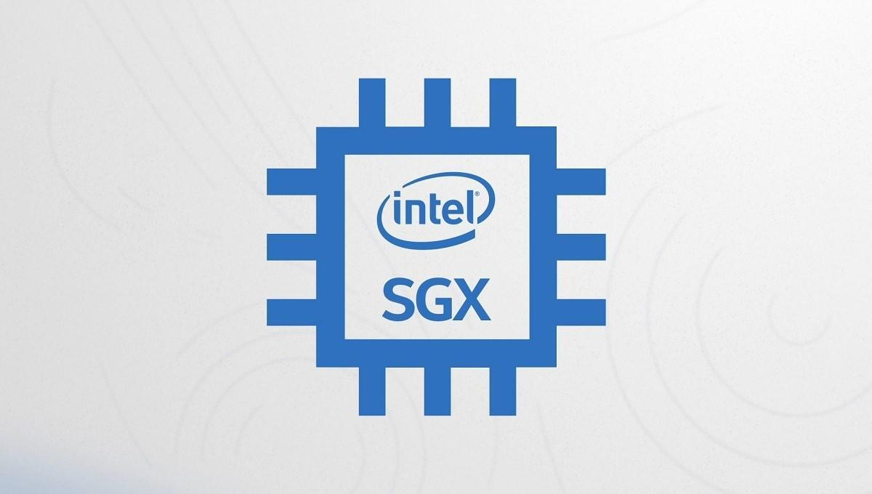


Independent Trust Domains
Notes:
In recent years, distributed trust systems, especially those deployed in the cloud, have resorted to using TEEs for this.
This is because TEEs are supposed to protect a node even if the cloud provider and OS goes rogue.
Both Signal’s Key Recovery and Azure Confidential Ledger uses it.

Slide 5
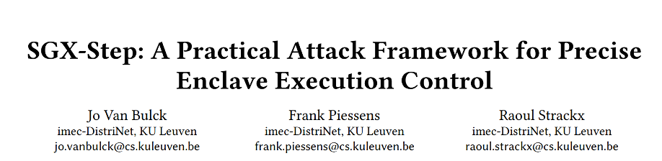
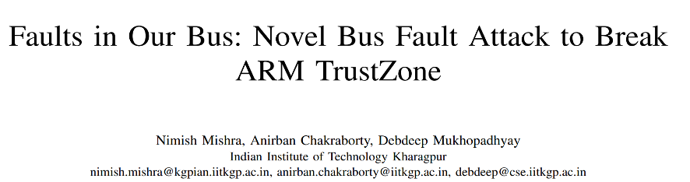
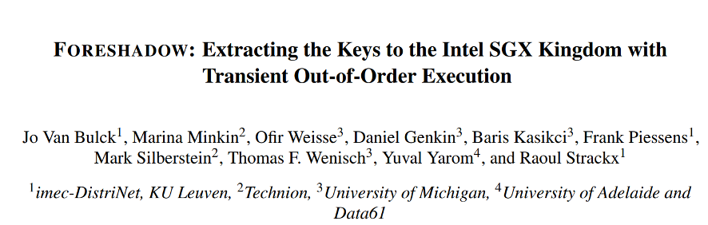
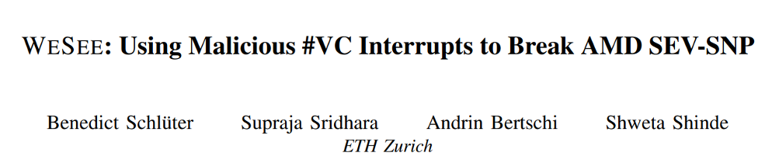
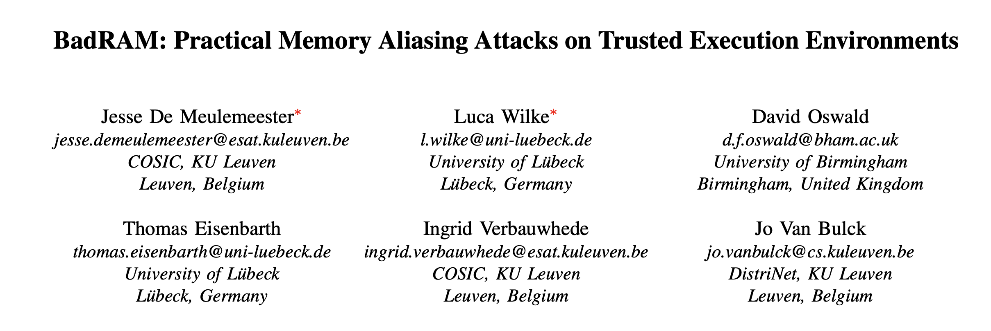
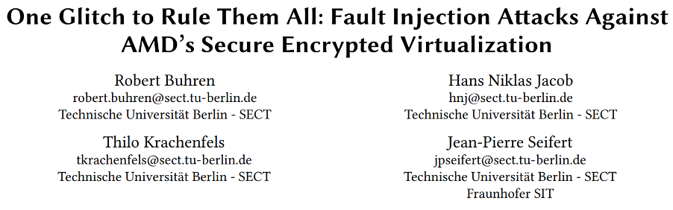
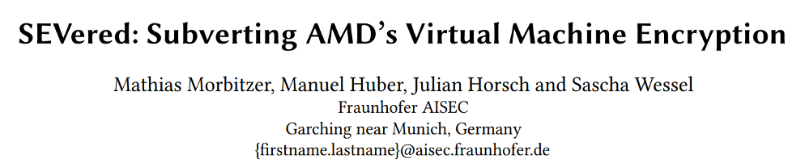
Attacks on external state
Attacks on execution
Mismatch in assumptions & guarantees
Secret Leakage
Notes:
TEEs today pretend to provide these impenetrable abstractions to a distributed systems developer. But security folks among us keep finding vulnerabilities in them.
Some of the attacks allow you to rollback state stored in disk and even in memory, some allow you to leak secret keys.
Even on a fundamental level, the developer’s mental model of the TEE guarantees may be different from what the TEE offers, given that these guarantees vary from provider to provider, and even change between versions.
For example, SGXv1 had memory integrity. Intel removed it in v2.
<Click>
But there is a more insidious problem here: If you find an attack on a TEE, it applies to all the TEEs in the cluster. Suddenly, the independent failure assumption is no longer valid.
So, is all hope lost? I will argue it isn’t.

Slide 6
What can we do?
Correlated Failures
Rare TEE Failures
Heterogenous Cluster
Auditing
Platform Fault Tolerance
PirateShip
Notes:
What can we do?
Cust having one type of TEE platform is hard to maintain safety in the long run.
<Click>
We must introduce heterogeneity in our cluster.
<Click>
So, to formalize this idea, we introduce the notion of Platform Fault Tolerance.
<Click>
Next, we want to understand how to use TEEs effectively. In one extreme, we consider them broken and take no advantage of them. But that’s too pessimistic as TEEs do raise the barrier to attack.
However, on the other extreme, we trust them to remain secure forever, which is also not true, as we saw in the last slide.
<Click>
So, how can we “mostly” trust TEEs?
In the common case, we assume TEEs are correct. But in the worst-case scenario a malicious node with a broken TEE could convince 2 different sets of nodes that 2 different versions of the log are correct. This is sometimes called Equivocation.
<Click>
For this, we provide auditing mechanism that checks for such issues.
<Click>
The key challenge is to do this without hurting performance.
This is exactly what the PirateShip does.

Slide 7
What can we do?
Correlated Failures
Rare TEE Failures
Heterogenous Cluster
Auditing
Platform Fault Tolerance
PirateShip
Notes:
Let’s talk about Platform Fault Tolerance first.

Slide 8
Platform Fault Tolerance
Failures
Independent Crashes
Correlated Maliciousness
Platforms capture Correlation
Notes:
First, let’s talk about Platform Fault Tolerance.
<Click>
A distributed trust node can fail in 2 ways:
<Click>
Crash failure: think of this as someone yanking the power cable. These happen randomly and independently <Click>
Malicious or “Byzantine” failures: These are caused by nodes going rogue and behaving arbitrarily. If this maliciousness is due to a TEE vulnerability, all nodes with the same TEE configuration are now susceptible, in the very worst case. But since distributed trust stores highly sensitive data, we must prepare for the worst. <Click>
It, therefore, makes sense to talk about such things in terms of independent failure domains or “platforms”.

Slide 9

Platform is an Independent Failure Domain
Notes:
What constitutes a platform depends on the sysadmin’s beliefs and paranoia.
For deployments within a cloud provider, one might consider nodes based on different TEEs to be in different platforms.

Slide 10
Platform is an Independent Failure Domain
Notes:
Since certain TEE attacks require physical access, one could envision <TEE, region> pairs to be different platforms

Slide 11


Platform is an Independent Failure Domain
Notes:
If possible, others might deploy in entirely different clouds. This is the approach Signal uses today.

Slide 12
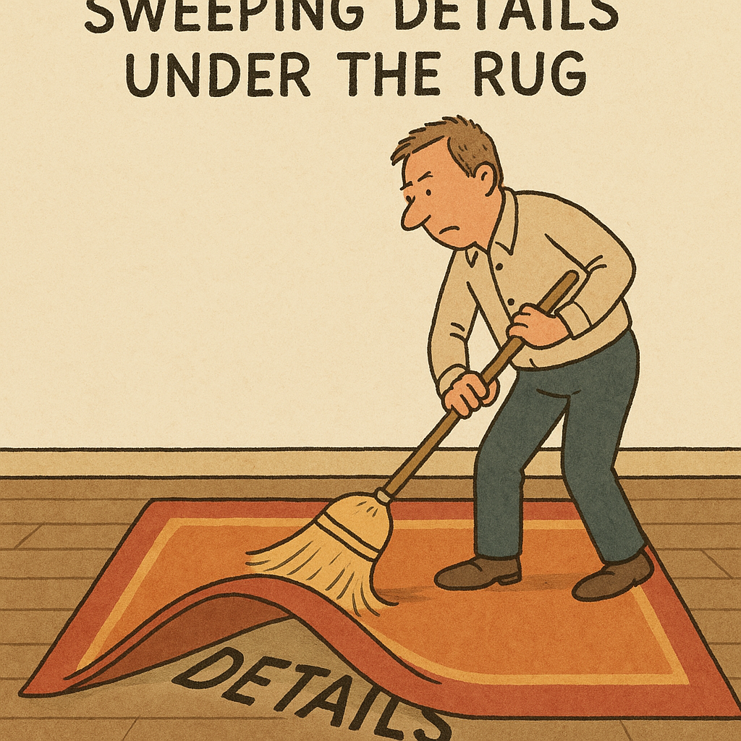



Example
$f_{p}=1, u=1$
$N_{p}$ independent platforms.
$f_{p}$ max concurrently malicious platforms.
$u$ max crash failures, in total.
Notes:
Let’s make things a bit more concrete.
<Click>
Say there are Np total platforms.
<Click>
PFT allows you to specify the threshold fp of platforms that can be malicious simultaneously.
<Click>
Since crashes are independent, PFT allows you to specify a GLOBAL threshold u of max nodes that can crash.
<Click>
PFT dictates which platform configurations are safe.
Let’s take an example, fp = 1, u = 1.
<Click>
Let’s see which platform configurations are safe.
In the coming examples, I want you to remember this motto: “Even if all the dead guys are good guys, the bad guys must not outnumber the good guys.”
<Click>
With 4 platforms, having 1 node in each platform therefore is safe.
Let’s see if we can do with 3 platforms,
<Click>
turns out lowest you can do is 5 nodes, with this (2, 2, 1) configuration. In the worst case, one of these big 2-node platforms can break down.
<Click>
However, no matter how many nodes you deploy, it is impossible to have a safe configuration with 2 platforms.
<Click>
There’s a lot of subtleties that I am sweeping under the rug due to time constraints.

Slide 13
What can we do?
Correlated Failures
Rare TEE Failures
Heterogenous Cluster
Auditing
Platform Fault Tolerance
PirateShip
Notes:
Now let’s discuss the PirateShip protocol itself.

Slide 14
What can we do?
Correlated Failures
Rare TEE Failures
Heterogenous Cluster
Auditing
Platform Fault Tolerance
PirateShip
Notes:
Let’s talk about Platform Fault Tolerance first.

Slide 15
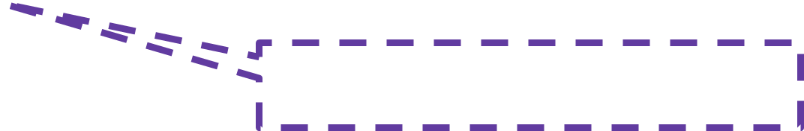
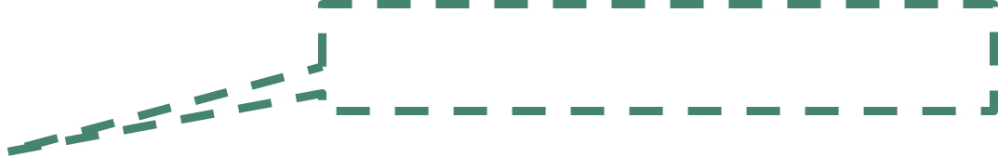
Dual notions of confirmation
Commit
Audit
Up to $u$ crashes
Up to $f_{p}$TEE platform failures
Notes:
Unlike other ledger consensus protocols, PirateShip has two notions of confirmation.
<Click> A transaction is first committed to a position in the ledger after being replicated properly. This is the only guarantee systems like CCF provide today.
<Click>
Then it is asynchronously audited to preclude any effect from malicious platforms.
<Click>
As such, a committed-only transaction prsists upto u benign crashes, but may be rolled back if there are malicious TEEs.
<Click>
But if it is audited, it persists as long as the number of malicious platforms remain below the threshold.

Slide 16
Dual notions of confirmation
Audit
Commit
Audited
Committed
Uncommitted
A
B
C
D
Audit/Commit
A
B
C
E
F
G
time
Audit
Commit
A
B
C
E
F
G
H
PirateShip lets YOU choose the max allowed gap
Notes:
How does this look from the ledger’s perspective?
We have 2 indices corresponding to audit and commit.
Audit always lags behind commit.
But the gap is bounded by a constant chosen by the sysadmin.
This reflects the cautious trust put on the TEEs.

Slide 17
Dual notions of confirmation
Audited
Committed
Uncommitted
time
Audit
Commit
A
B
C
E
F
G
H
Notes:
<Transition slide; auto forwards after 500 ms>

Slide 18
Dual notions of confirmation
Audit
Commit
Audited
Committed
Uncommitted
A
B
C
E
F
G
H
Audit
Commit
A
B
C
E
F
G
time
On benign crashes
Audit / Commit
A
B
C
E
On rare TEE failures
Notes:
On benign crashes, only uncommitted entries can be deleted.
<Click>
But on rare TEE faults, even committed entries can be deleted.
However, audited entries will always persist.

Slide 19
Not all transactions are equally impactful!
Adding a Read-only replica
High $$ Transfer
Low $$ Transfer
Constitution Change
PirateShip lets YOU choose who pays the cost!
Notes:
Now, you may ask the question, how long should I wait before I consider my transaction confirmed? Should I wait for commit or the audit?
Well, it depends.
<Click>
In a system, there are often operations that are very sensitive and must not be rolled back ever. They must wait for audit.
Others will be happy to be rolled back and reapplied every once in a while.
<Click> PirateShip gives the app developer the power to choose how long to wait on a per-transaction basis.

Slide 20
Secret Sauce
Embedding asynchronous BFT logic inside a CFT protocol
without sending extra messages!
Notes:
<Literally just read the slide out loud>

Slide 21
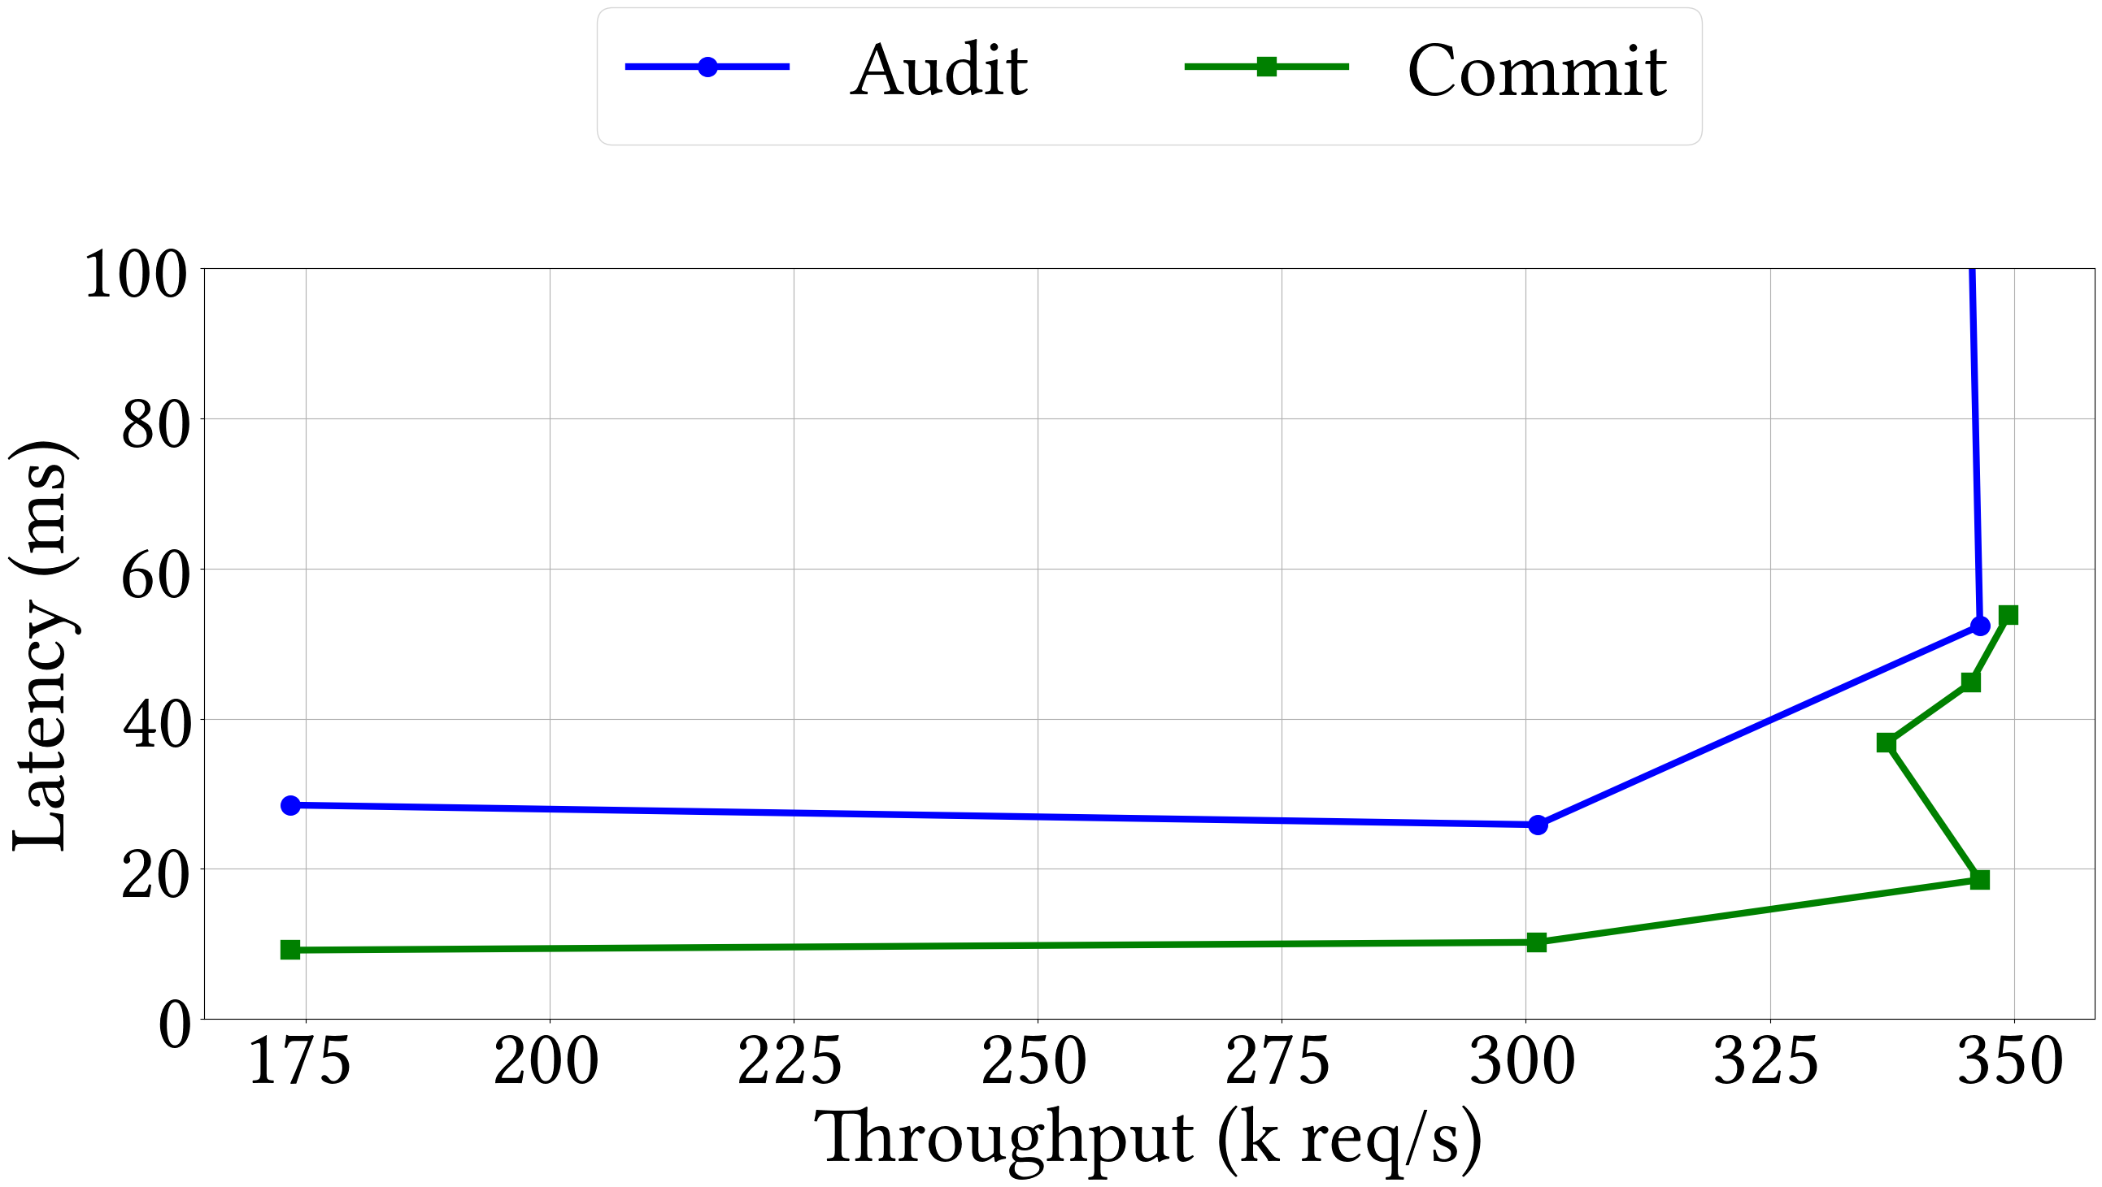
Performance
Throughput comparable to SOTA CFT protocols
Audit Latency comparable to SOTA BFT protocols
Commit Latency comparable to SOTA CFT protocols
Notes:
In the remaining time, let me quickly run through some performance number.
On a LAN based setup with 7 nodes, PirateShip has similar throughput as Autobahn and a modified version of Raft that includes signatures.
<Click>
PirateShip commit latency is similar to that of Raft and its audit latency is even lower than Autobahn.

Slide 22

Conclusion
Platform Fault Tolerance
Realistic model of TEE-based clusters
PirateShip
High performance PFT consensus protocol
Audit
Commit
A
B
C
E
F
G
H
Questions?
shubham_mishra@berkeley.edu
Notes:
In conclusion, we present PFT a realistic model to view TEE-based clusters, and PirateShip, a high performance PFT consensus protocol.
We have open sourced a prototype recently. Scan the QR code to follow our progress.
We are also talking to the CCF team in Microsoft to integrate PirateShip.

